Slide 1
Electric
Skateboard
(SUMMER CHALLENGE)

Slide 2
Contents
Overview
Understanding the problems
Project objective
Target audience
Available solutions
Proposed Solutions
Components Required
Block Diagram
Estimated Cost
Steps Involved in Designing
Final Design
Pros and Cons of available solution
Pros and Cons of proposed solution

Slide 3
Overview
As part of Summer challenges, we students of IIT Jodhpur have designed a single seater E-skateboard. The vehicle is designed to be lightweight, safe and easy to maintain. The team has been instrumental in coming up with innovative ideas and has applied sound engineering principles while designing the E-skateboard.
In order to accomplish this goal we have done a great research about the current scenario and how we can work to improve it. Our main objective is to keep the price as minimum as possible along with a reliable end product.

Slide 4
Understanding the problems
01
With the increasing pollution and depletion of natural resources there is a need for the expansion of Electric drive enabled vehicles.
02
Keeping our campus into account,the extreme hot weather and the vastness of our campus makes it difficult to travel easily inside the campus.Hence a need of transportation was felt to be established.
03
And being a green campus, we need to have to have a Environmental friendly solution keeping the speed limit of 20 km/h in our minds.

Slide 5
Project objective
Our main aim is to design an E-skateboard which will have less cost than already present skateboards available in the marker. It will be really helpful for people to travel short distances and will be budget friendly. In the campus of IIT Jodhpur, it can be used by students to travel inside campus in lesser time and also being electric it won’t cause any pollution.,

Slide 6
Target audience
Initial target audience will be the residents of our campus . And as soon as it succeeds in our campus we would try to target nearby college campus to help and improve the Electric drive scenario in our country so that we can reduce pollution and at the same time be economically beneficial.

Slide 7
Available Solutions
A variety of E -skateboards are available in the market now-a-days. While some E-boards can cost an upwards of $2000, one is able to find a quality board for around $1000 or less. A lot of companies such as Boosted,Evolve,The ELectric Boarding Company,Skatebolt,etc. Are manufacturing E-skate boards commercially for people all over the globe. Some of the available models are listed on the next slide.

Slide 8
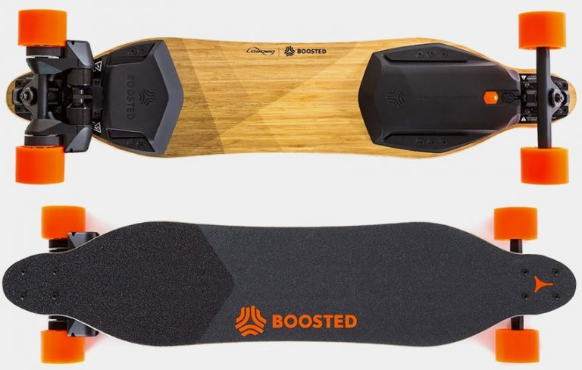
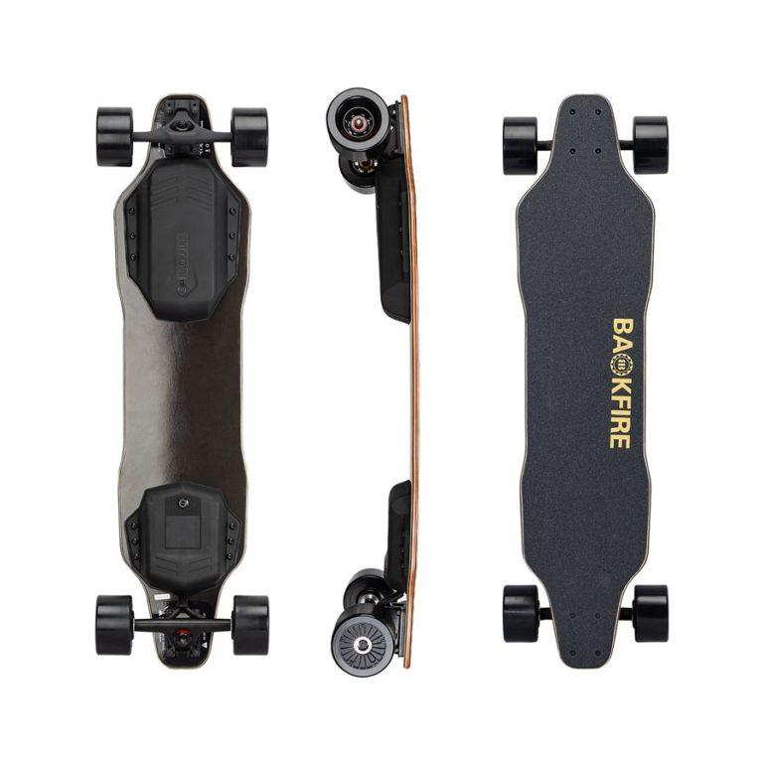
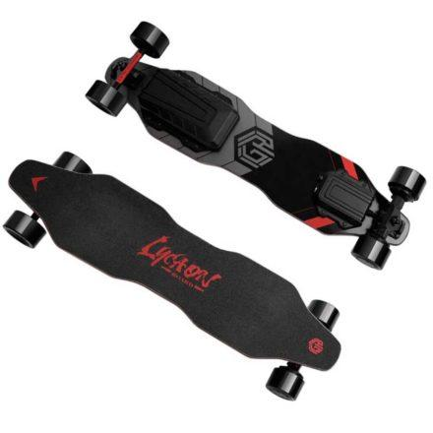
Boosted Dual+
It is the fastest electric skateboard. It is popular for its excellent quality and long lifespan. The mileage of the board is 7 miles in the ECO mode and 6 miles in expert mode. It weighs 15 pounds with a deck length of 27 inches and width of 10 inches.
Battery recharge time is an hour.
Price : 1399$
Backfire G2
With a top speed of 24 miles per hour, the Backfire G2 packs the performance punch although Its reduced range of only 11 miles spells trouble. It has a low recharge time of only 3.5 hrs and weighs 14.5 pounds. The dual 350 W motors provide sufficient power.
Price: 549$
Lycaon GR
This electric skateboard has two powerful motors of 480 Watts which allow riders to cruise at a maximum speed of up to 26 miles per hour and a range of 15 mile. For charging 270 Wh battery the fast charger option only adds $30 to the total cost of the device, and it reduces the charging time from 5-6 hours to 3-4 hrs.
Price: $ 399 , $499(Fast charger)

Slide 9
Proposed Solution
An electric skateboard with maximum speed of 20 kmph and which can be used by people of average weight
Components Required
Battery
Motor
Motor Controller
Skate Board
Handle
Brakes
Throttle Controller
Miscellaneous
Fixtures, wires, containers

Slide 10
Battery
1. Battery
Batteries operate by converting chemical energy into electrical energy through electrochemical discharge reactions. Batteries are composed of one or more cells, each containing a positive electrode, negative electrode, separator, and electrolyte. Cells can be divided into two major classes: primary and secondary.
TYPES OF BATTERY
Primary cells are not rechargeable and must be replaced once the reactants are depleted. Examples of primary cells include carbon-zinc (Leclanche or dry cell), alkaline-manganese, mercury zinc, silver-zinc, and lithium cells
Secondary cells are rechargeable and require a DC charging source to restore reactants to their fully charged state. Examples of secondary cells include lead-lead dioxide,nickel-cadmium, nickel-iron, nickel-hydrogen, nickel metal hydride, silver-zinc, silver-cadmium, and lithium-ion.
We chose two 12V 10Ah Lithium ion batteries.
Specifications
Battery-type | Lithium-ion
Voltage | 12V
Weight | 649g
Capacity | 10 Ah

Slide 11
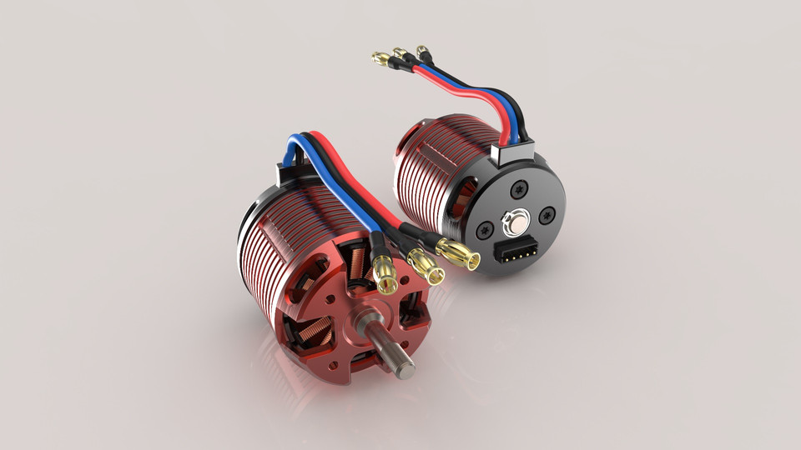
Motor
Two types of motors are in use widely for electrical drive.They are Hub motors and Belt motors. We will be using Belt motors because they provide better acceleration, are affordable and provide longer operational lifetime.
From the table below one can easily see that both motors are good enough and it is just a trade off for our requirements.
We chose a 2750 RPM 24V 250 W motor for the product.
Specifications
Rated Speed | 2750 RPM
Rated Power Output | 250W
No-load current | 0.7-1.4A
Rated current | 14A
Weight | 1.9kg

Slide 12
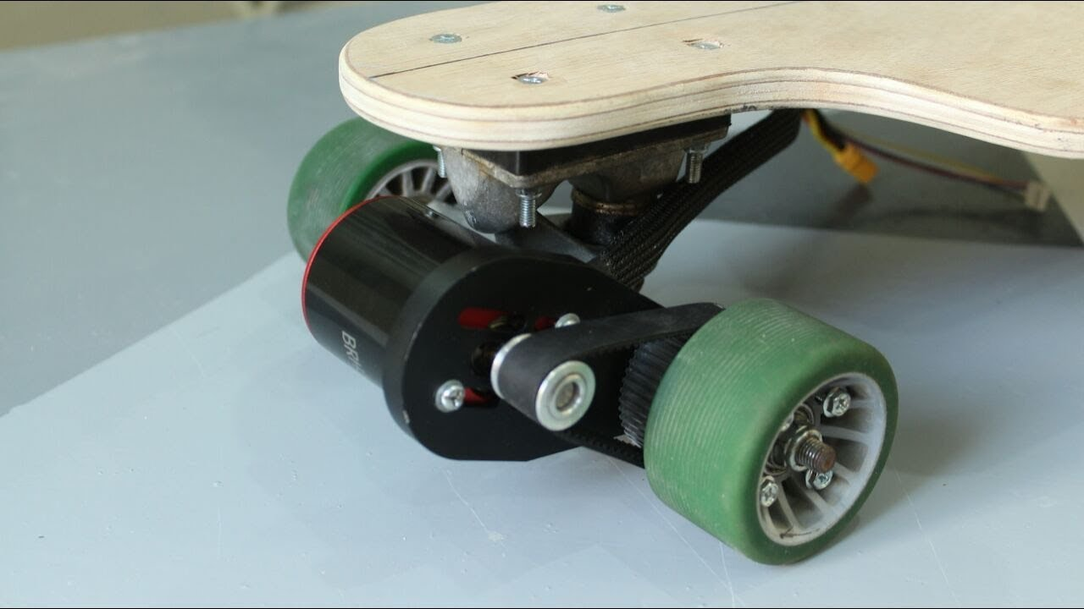
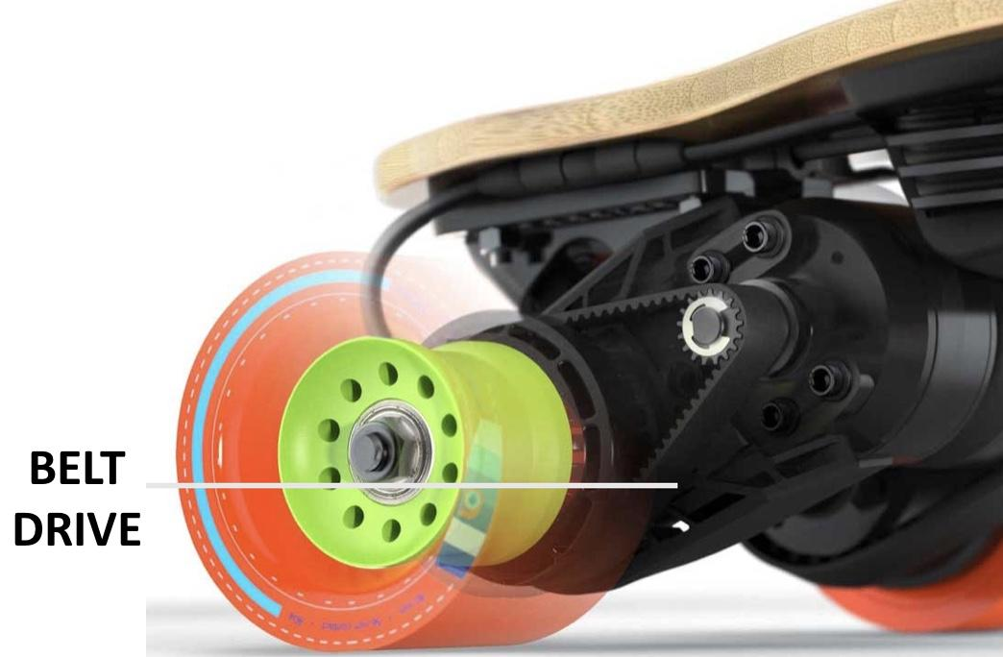

Slide 13
Motor Controller
A DC motor controller is any device that can manipulate the position, speed, or torque of a DC-powered motor.
Voltage | 24V DC
Under pressure | 20V±1
Current Limit | 21A ±1
Level Brake | High/Low
Turn Voltage | 1.1 - 4.3 V
Phase angle | 60 /120
Power | 250W

Slide 14
The benefits of using a controller.
Electrical protection of the motor and subsequently the mechanics.
Maintains constant speed, even when loads are changing.
Dynamic response to changing system demands, even in a braking condition with 4 quadrant drive.
Monitoring to evaluate machine performance / diagnostics.
Energy saving.
Accurate speed control.
We are using a 24V250W Motor Controller incorporated under Voltage protection 20 Volts. Current limiting feature prevents controller and motor damage due to over-current conditions.

Slide 15
Skate Board
We are going to use a standard skateboard for adults.
Specifications
Handle
Brakes
Throttle controller
Width | 10 inch
Height | 40 inch
Body | Wood

Slide 16
Block Diagram
WHEELS
MOTOR
BREAK
CHARGING UNIT
CONTROL UNIT
ACCELERATOR
BATTERY

Slide 17
Estimated cost
Sr no | Component | Units | Cost(in Rs)
1. | Skateboard | 1 pcs | 750
2. | Battery | 2 packs | 3480
3. | Motor and Motor Controller | 1 combo | 2850
4. | Belt pulley system and gears | 1 combo | 200
5. | Handle | 1 pcs | 10
6. | Brakes | 1 pcs | 300
7. | Throttle controller | 1 pcs | 100
5. | Miscellaneous (Fasteners etc) |  | 100
 | Total Cost |  | 7790

Slide 18
The estimated cost mentioned here is the cost of production of one prototype. It will surely be lower for bulk production as for full scale production of such kinds of vehicles with self made components (handles,throttles and maybe the skateboard) will reduce the cost of production even further. Also when manufacturing in bulk we will get the materials at a cheaper price which will eventually reduce the price of the E-Skateboard. With an expected production of 10000 skateboards per month, the average variable cost of the board can be reduced by 50 percent and we can make a board within 4000 INR.

Slide 19
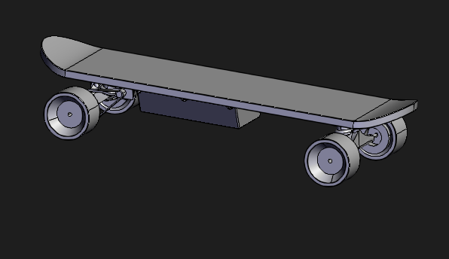
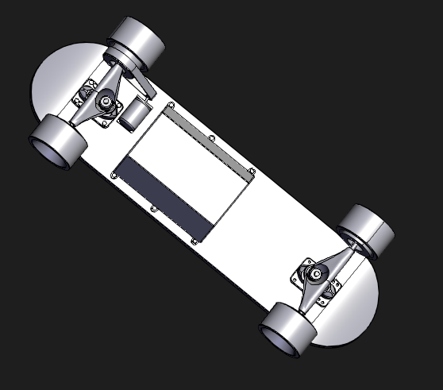
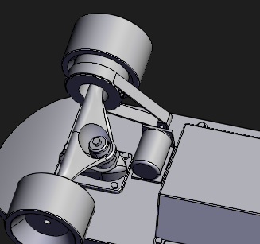
Final Design of the Skateboard
Here are some of the CAD representations of the final design of skateboard
Isometric Side view of the Skateboard
Bottom View of the Skateboard
Zoomed view of motor and wheel assembly

Slide 20
Steps involved in Designing
Defined the Problem
There are plenty of electric skateboards available in the market but their cost is too high. The main problem is making them available on affordable prices so that it can reach a larger number of people.
Collected information
We gathered a lot of research papers and blogs in which they explained the various aspects of manufacturing electrical skateboards. We studied the existing solutions and also watched videos regarding the same.
Analyzed Ideas
We analyzed the different ways of cost reduction as well as use of quality components to make our skateboard . For instance how to control the throttle i.e. via bluetooth receiver or by making wired connections
We also did the calculations and checked online about what are the specifications of the components that we are going to use.
Compared Solutions
We compared various solutions available in the market such as whether to use hub motor or belt motor and which type of batteries to use among all the possible options.Thus we filtered out all the components that had specifications of our requirement and were helping in cost reduction
Developed Solution
We then combined all those components.

Slide 21
Pros and cons of available skateboards
Pros
They have a very high speed.
A practical means of urban transportation
Skate up hill very well
Wireless control features enable the rider to control speed and acceleration at the touch of a button
Cons
The skateboards are too costly and can’t be afforded by masses.
They are very difficult to customize.
Sometimes it is very heavy to carry around.

Slide 22
Pros and Cons of the proposed solution
Pros
The main aspect which we will be focusing on will be making the board cost effective. because there are many boards available in the market but they are not quite affordable for everyone.
The components used in the board are easy to maintain due to lesser complexity of the circuit.
The components proposed are the ones which are long lasting as well as cost effective.
The product is lightweight.
Cons
Being cost effective and of adequate size the speed limit as well as travelling distance will be of average numbers.
Usage limited to one person at a time.
It has weight limit for the driver/user

Slide 23
Thank you!
Team
Gautam Jain (B16ME009)
Suyash Agnihotri(B19ME084)
Bhawna Chopra(B19EE016)
We would like to thank our college for giving us the opportunity to explore and learn something new.
We would also like to thank our mentor who helped us to stay focussed, helped us to think out of the box and motivated us throughout. We thank him for all his support.

